Slide 1

Large Scale Data Driven Applications
Big Data for Large-Scale Data-Driven Applications

Slide 2



Big Data
Which one is bigger?
Now
Which one is bigger?

Slide 3

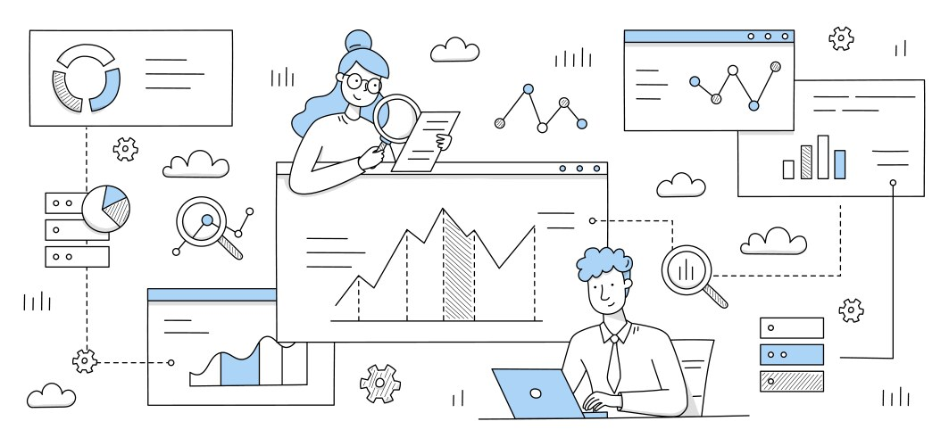


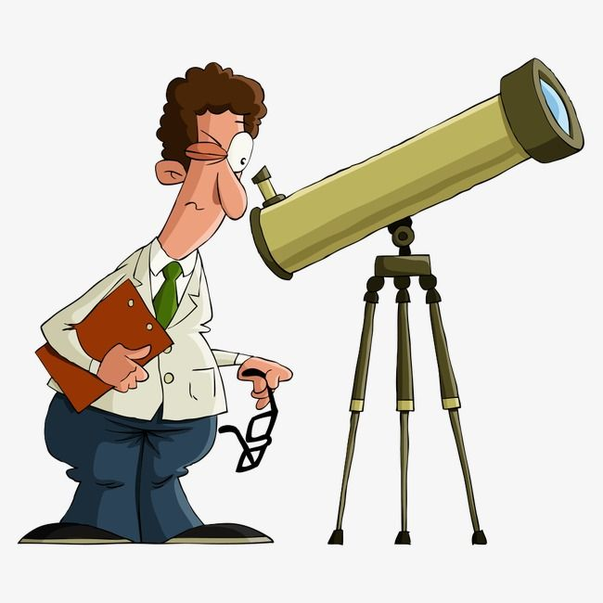

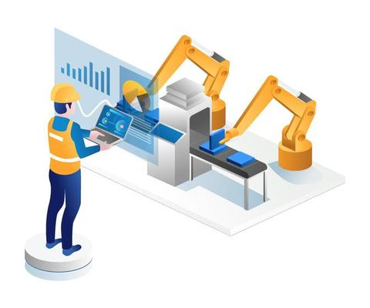

What is Big Data?
Data that will not fit in hard disks
data with a large number of observations and/or features
traditional computer science
statistics
non-traditional sample size (i.e. > 300 subjects); can’t analyse in stats tools (Excel)
other areas

Slide 4
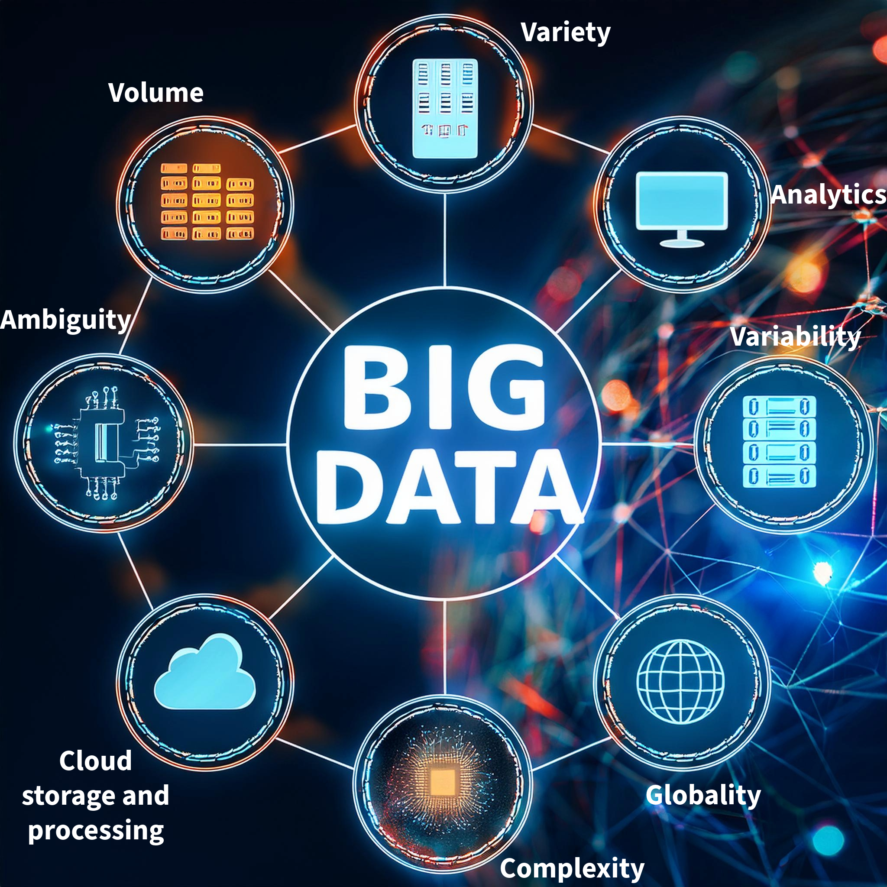
What is Big Data?
buzzword?
revolution?
No standard definition
Gartner: “Big Data” is high volume, high velocity, and/or high variety information resources that require new forms of processing to enable enhanced decision making, insight discovery and process optimisation.

Slide 5



What is Big Data?
Big Data refers to extremely large datasets that are too complex to be processed and analysed using traditional data processing tools. It is characterised by the "3 V's": Volume (massive amounts of data), Velocity (rapid generation of data), and Variety (different types and formats of data).
Big data refers to extremely large and complex datasets that are difficult to process using traditional data processing tools. These datasets are characterised by their volume (massive amounts of data), velocity (rapid generation and processing), variety (diverse data types), veracity (quality and accuracy), and value (potential for creating business value).
Big data refers to extremely large, diverse, and complex datasets that exceed the capabilities of traditional data processing systems. It's characterised by high volume, variety, velocity, and variability, requiring advanced technologies for storage, processing, and analysis.

Slide 6

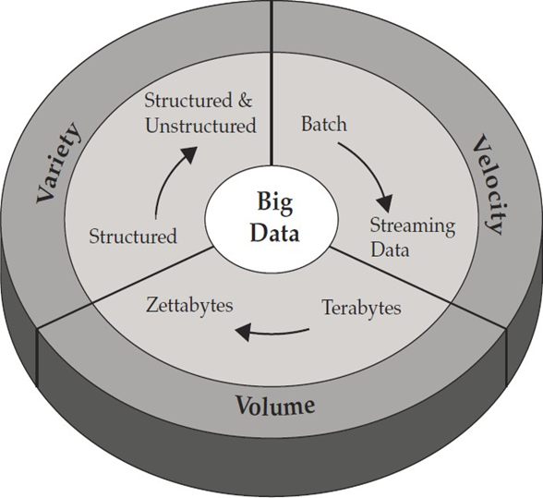
Big Data: 3V’s

Slide 7
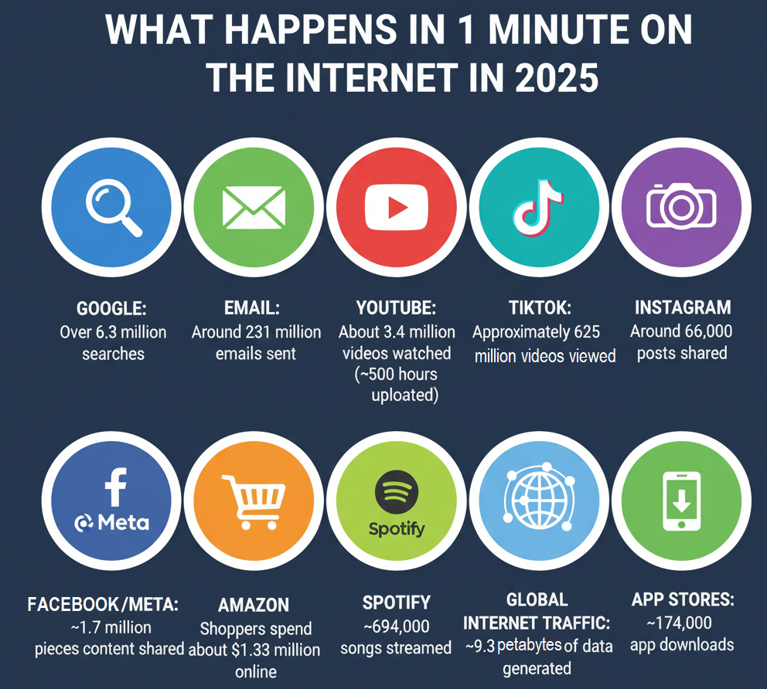
Big Data Characteristics: Volume

Slide 8
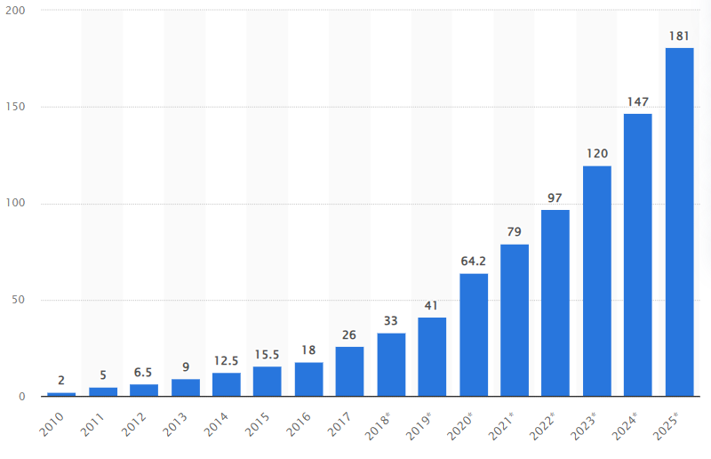
Big Data Characteristics: Volume
*one zettabyte is equal to a trillion gigabytes
Data generated (zettabytes)
Source: statista.com
Amount of data generated each year from 2010 to 2025 (estimated)

Slide 9
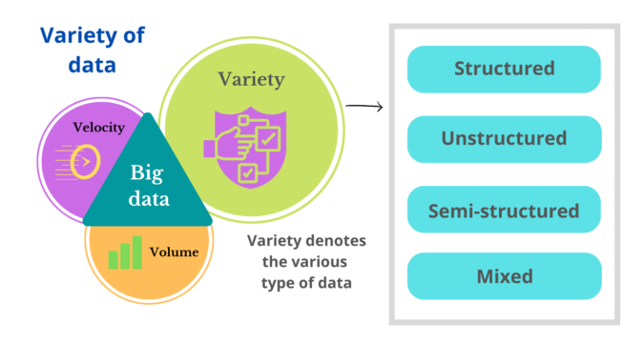
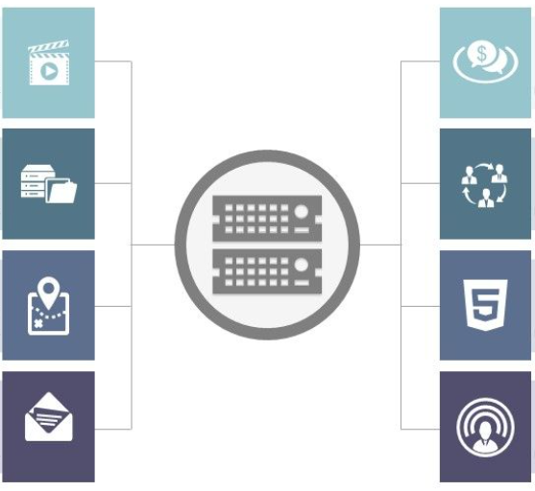
Big Data Characteristics: Variety
Images and Media
Variety of sources produce variety of data
Click stream
Database
Social media
Locations
HTML (websites)
Email
IoT Sensors

Slide 10
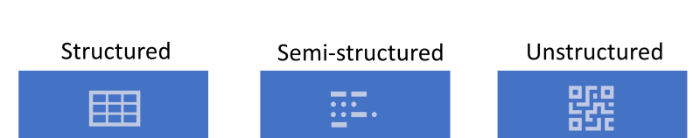
Big Data Characteristics: Variety
Data is well organised.
Organised by the means of relational databases.
Matured transaction, multiple concurrency techniques.
Tuples, rows, and tables.
Schema dependent and less flexible.
Data is organised to some extent.
Partially organised, e.g. XML/RDF
Transaction is adapted from DBMS, but data concurrency can cause problem.
Tuples and graphs are possible.
Data is more flexible than structured.
Data is fully unorganised.
Based on character and binary data.
Difficult, but achievable transaction management and data concurrency.
Versioning usually on whole data or chunks.
The most flexible.
Source: https://10senses.com/

Slide 11
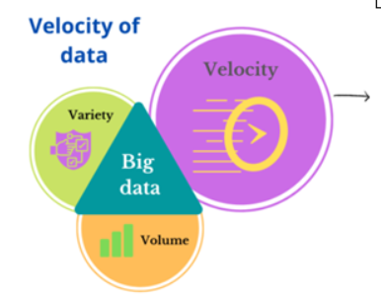
Big Data Characteristics: Velocity
Speed of growth and transmission of data
Just imagine
Modern cars have close too 100 sensors to monitor different parameters
Global financial markets collectively handle petabytes of trade-related data in each trading session

Slide 12

Big Data Characteristics: Velocity
Data is being generated fast and need to be processed fast
Online Data Analytics
Late decisions ➔ missing opportunities
Examples
E-Promotions: Based on your current location, your purchase history, what you like ➔ send promotions right now for store next to you
Healthcare monitoring: sensors monitoring your activities and body ➔ any abnormal measurements require immediate reaction

Slide 13
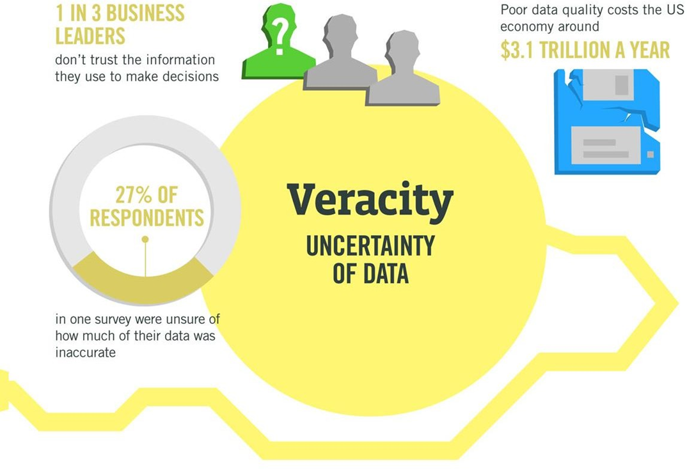
Big Data Characteristics: Veracity
Uncertainty due to inconsistency, incompleteness, ambiguities, or approximations.
Source: http://www.ibmbigdatahub.com/

Slide 14
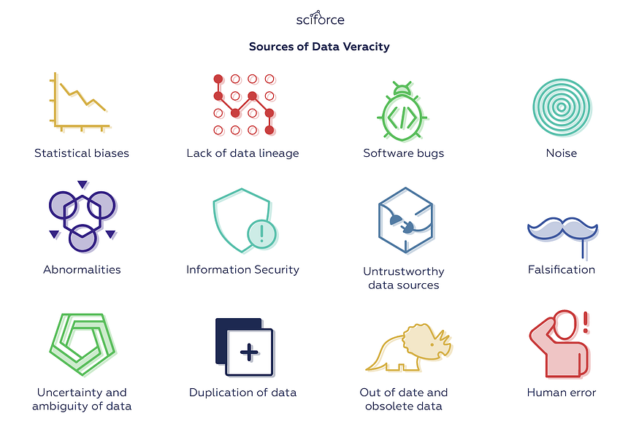
Sources of Data Veracity
https://medium.com/

Slide 15
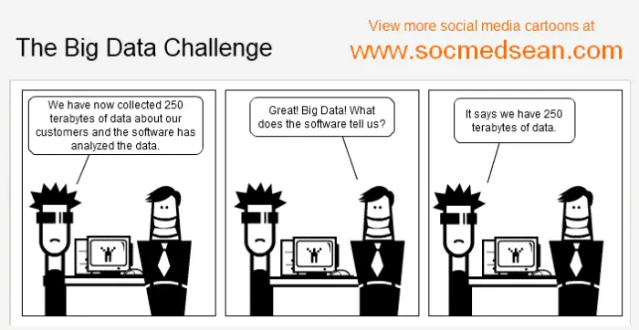
We have an abundance of data—what's next?
Big Data holds no value if you can't analyse it and act accordingly!

Slide 16
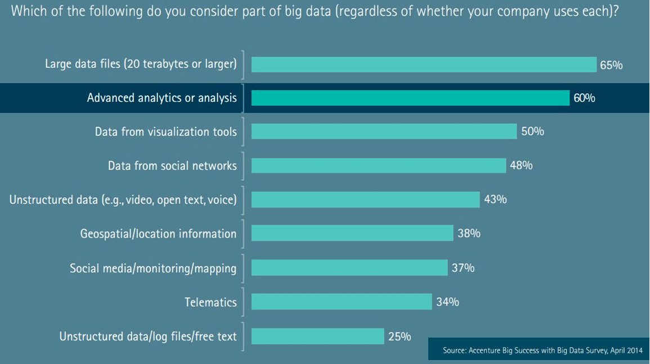
Big Data—Industry View

Slide 17

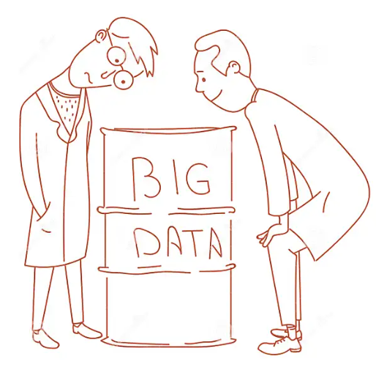
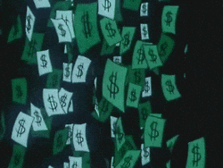
Big Data Analytics
Analytics
Insights

Slide 18
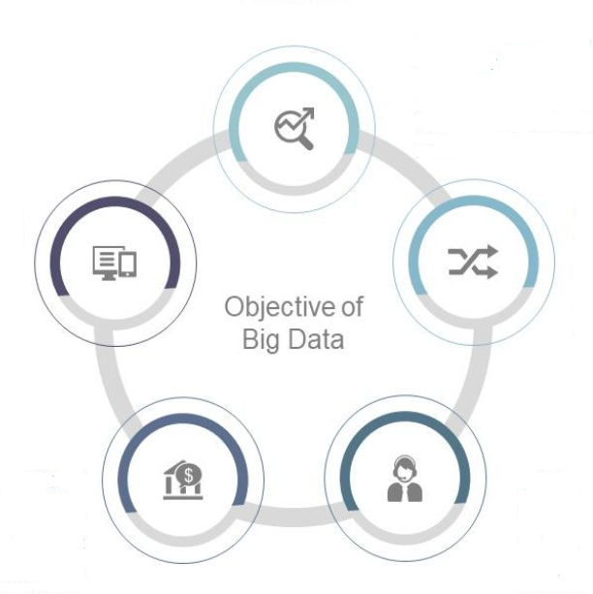
Big Data Analytics: Objectives
Analysing user behaviour
Reacting quicker to market trends
Combining data from multiple sources
Generating additional revenue
Improving service provision

Slide 19
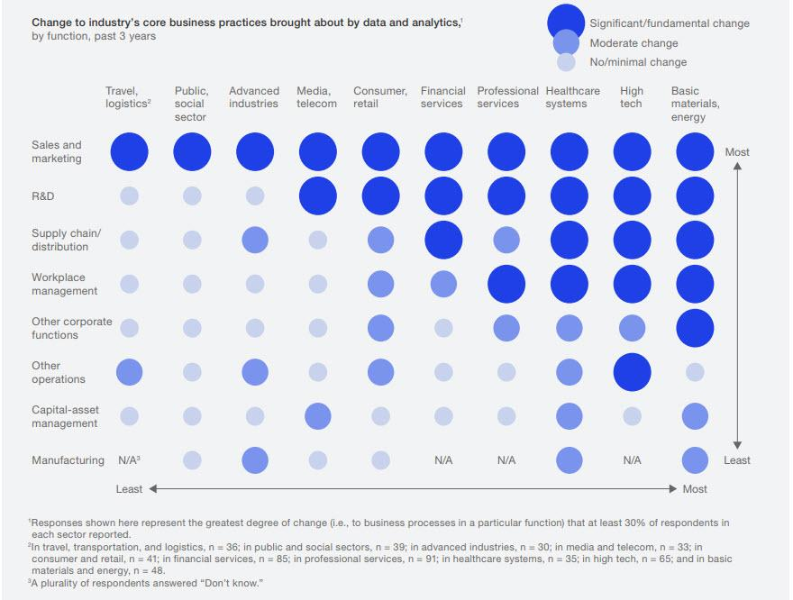
Big Data Characteristics: Value
Based on McKinsey Analytics survey
Nearly 50% of respondents indicated that Big Data and Analytics have transformed their sales and marketing practices
Over 30% of respondents noted that R&D has been transformed, particularly in High Tech and Basic Materials & Energy sectors
Source: https://www.forbes.com/

Slide 20
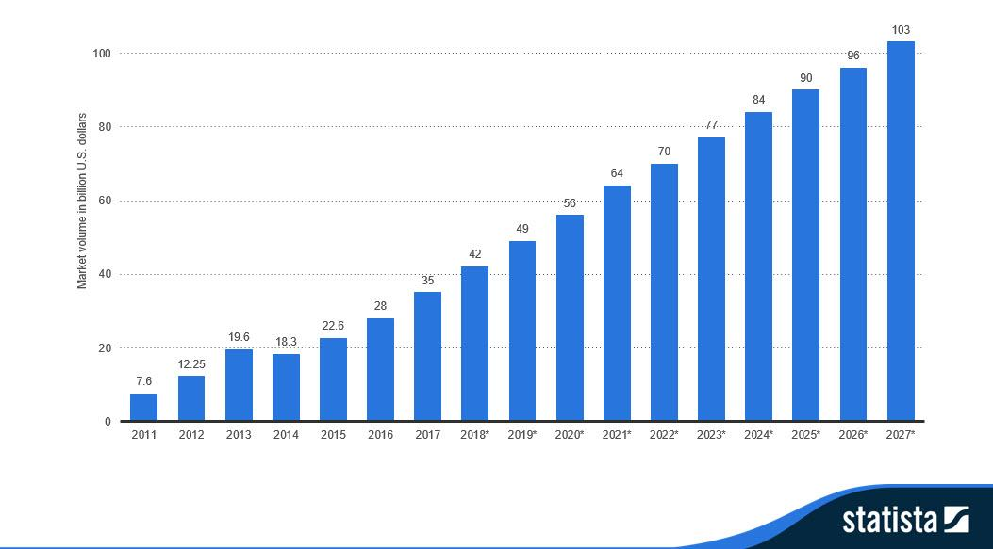
Big Data Characteristics: Value
Big Data Market Size Revenue Forecast Worldwide from 2011 to 2027

Slide 21
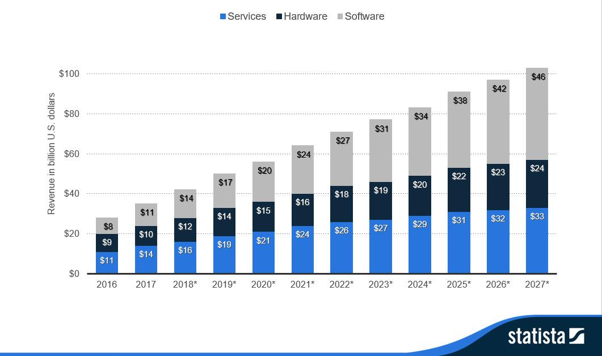
Big Data Characteristics: Value
Big Data Revenue Worldwide from 2016 to 2027, by major sectors

Slide 22
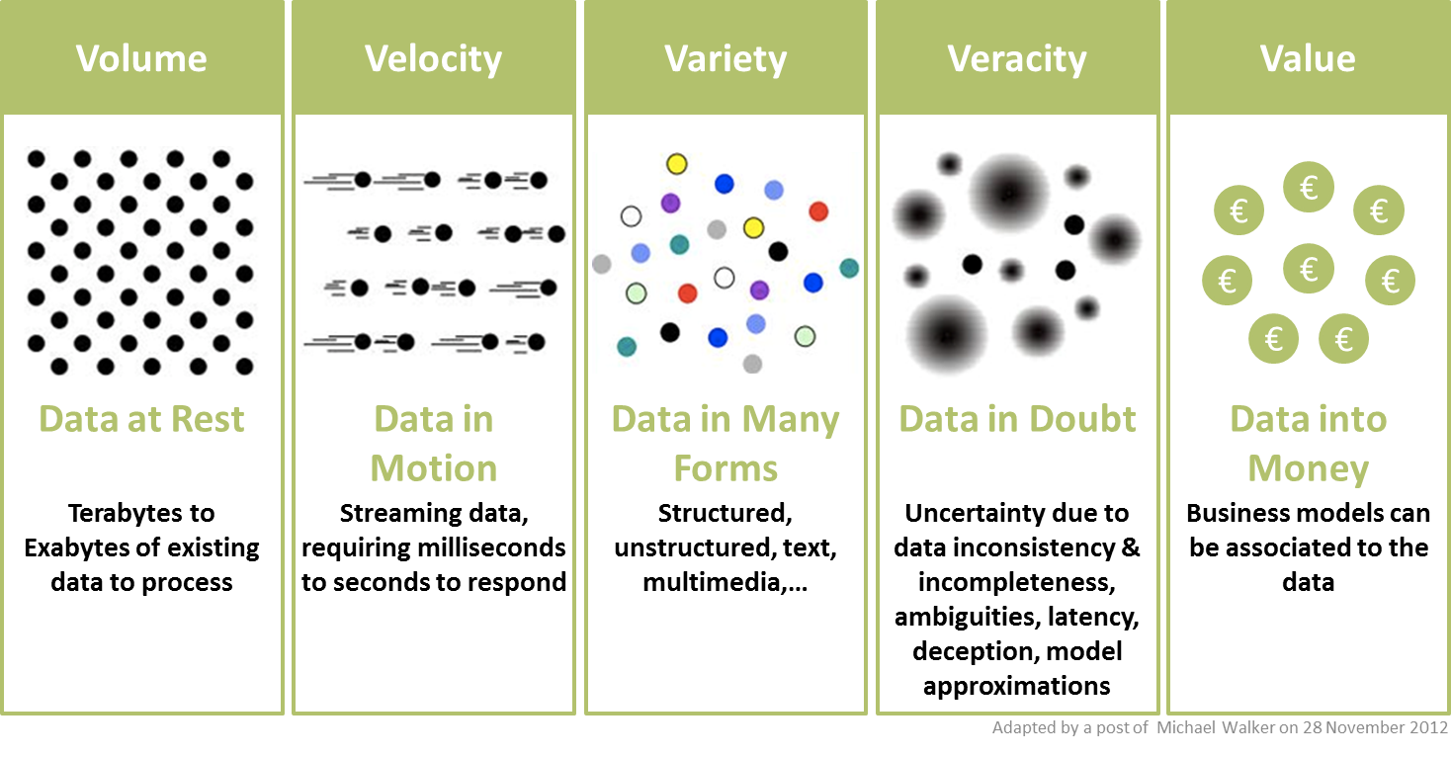
Big Data Characteristics: Summary
Source: https://informationcatalyst.com/

Slide 23
Processing Big Data
OLTP: Online Transaction Processing (DBMSs)
Database applications
Storing, querying, multiuser access
OLAP: Online Analytical Processing (Data Warehousing)
Answer multi-dimensional analytical queries
Financial/marketing reporting, budgeting, forecasting, …
RTAP: Real-Time Analytic Processing (Big Data Architecture & Technology)
Data gathered & processed in a real-time
Streaming fashion
Real-time data queried and presented in an online fashion
Real-time and history data combined and mined interactively

Slide 24
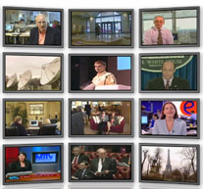
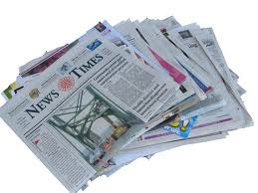
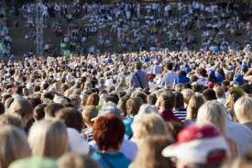

Data Generation and Consumption Model has Changed
The Model of Generating/Consuming Data has Changed
Old Model: Few companies are generating data, all others are consuming data
New Model: all of us are generating data, and all of us are consuming data

Slide 25

Real-Time Analytics/Decision Requirement
Product
Recommendations
that are Relevant
& Compelling
Learning why Customers
Switch to competitors
and their offers; in
time to Counter
Influence
Behaviour
Friend Invitations
to join a
Game or Activity
that expands
business
Customer
Improving the
Marketing
Effectiveness of a
Promotion while it
is still in Play
Preventing Fraud
as it is Occurring
& preventing more
proactively

Slide 26

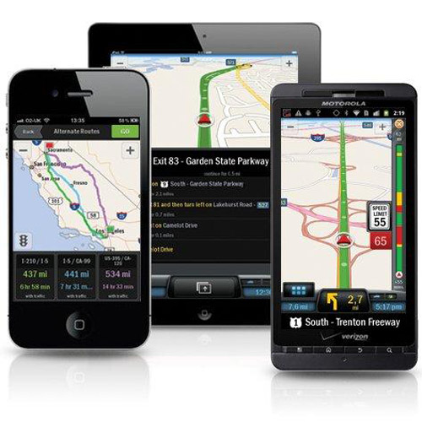
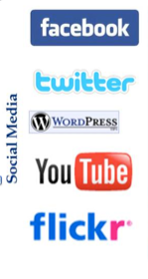
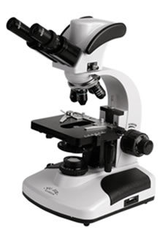
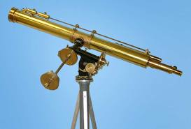
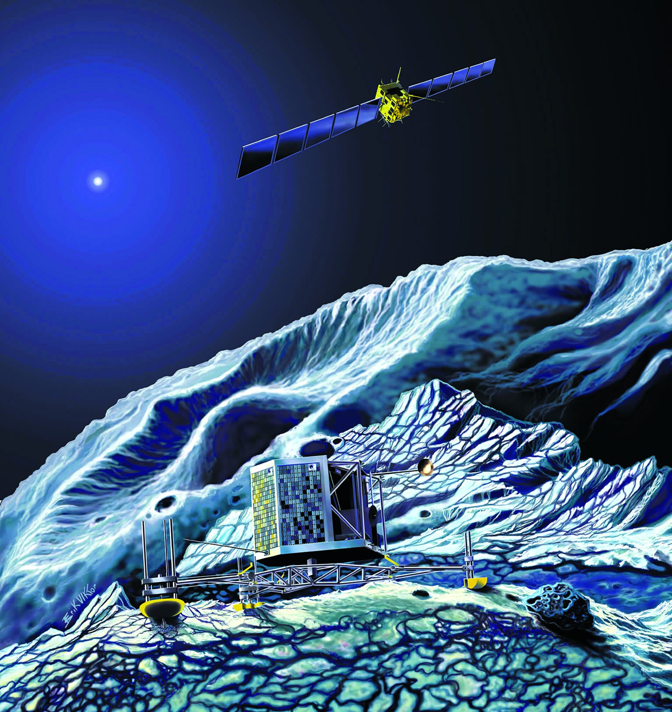
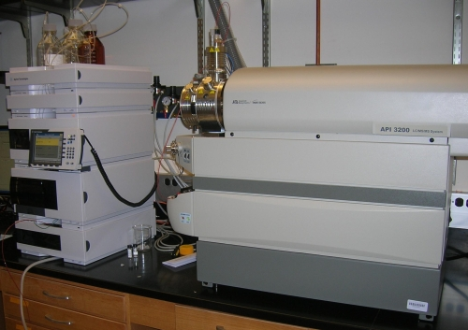
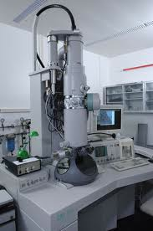
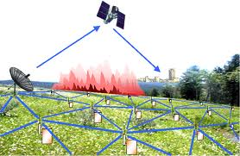
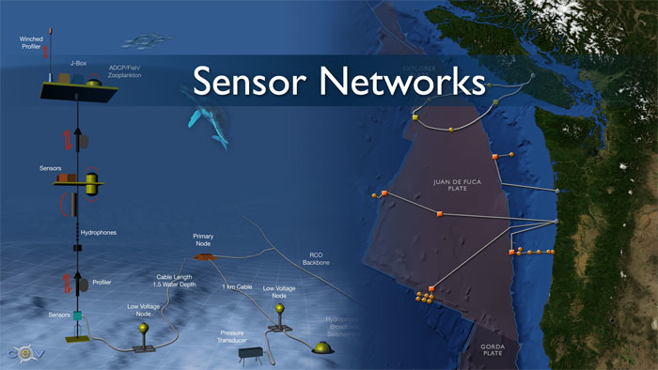
Real-time/Fast Data Processing Requirement
Mobile devices
(tracking all objects all the time)
Scientific instruments
(collecting all sorts of data)
Social media and networks
(all of us are generating data)
Sensor technology and networks
(measuring all kinds of data)
The progress and innovation is no longer delayed by the ability to collect data
But, by the ability to manage, analyse, summarize, visualise, and discover knowledge from the collected data in a timely manner and in a scalable fashion

Slide 27
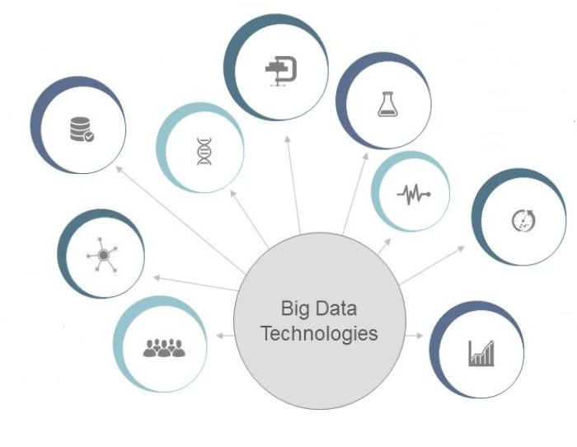

Key Big Data Processing Related Technologies
Machine Learning
Genetic algorithms
Simulation
Data integration
Signal Processing
Time series
Data fusion
Natural Language Processing
Crowd sourcing

Slide 28
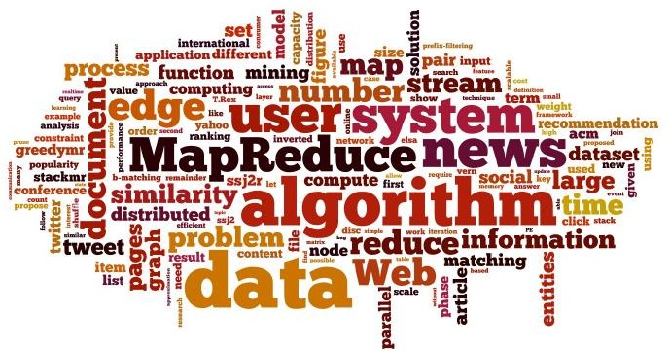
Key Big Data-Related Technologies
Distributed file systems
NoSQL databases
Grid computing, cloud computing
MapReduce and other new models
Large scale machine learning

Slide 29
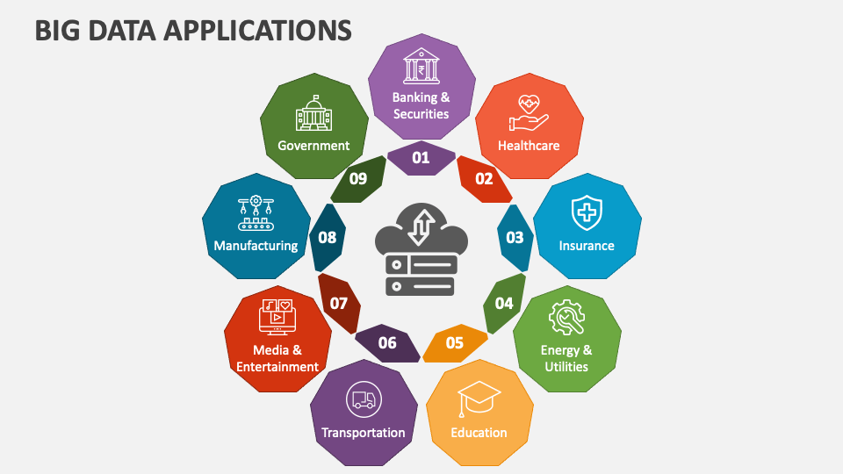
Big Data Applications
Source: https://www.collidu.com/

Slide 30
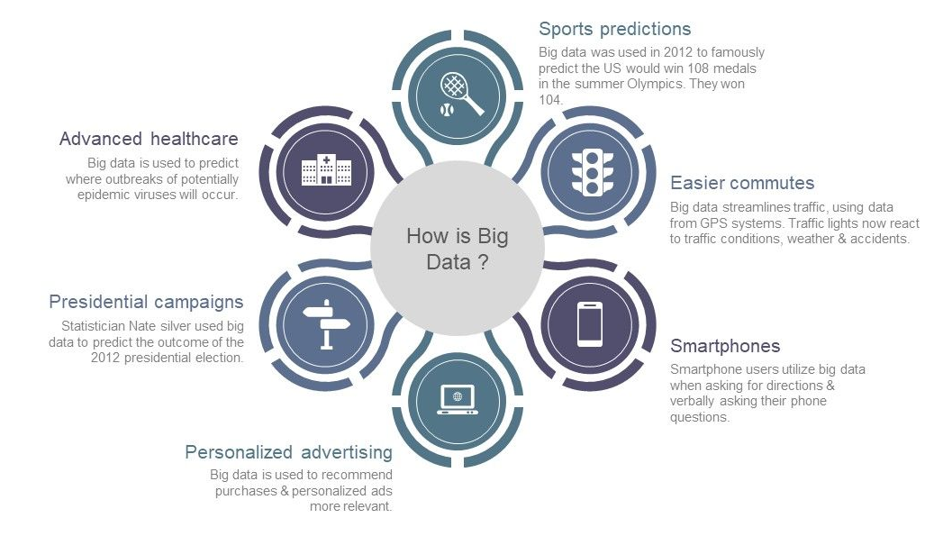
Impacts of Big Data
Source: https://www.slideteam.net/

Slide 31
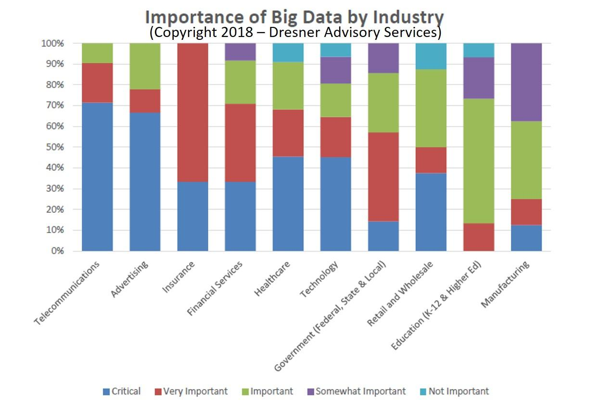
Big Data: Challenges and Opportunities
Notes:
https://www.forbes.com/sites/louiscolumbus/2018/12/23/big-data-analytics-adoption-soared-in-the-enterprise-in-2018/

Slide 32
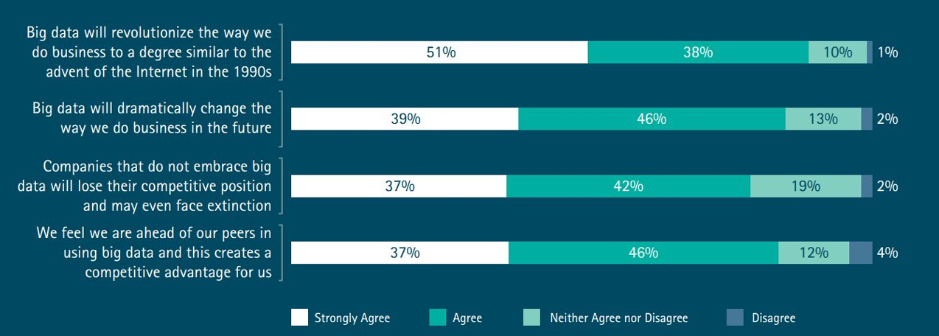
Big Data: Challenges and Opportunities
According to Accenture Big Success With Big Data Survey
Big data’s competitive significance
Notes:
89% said they view big data as a catalyst to transform their company into a digital enterprise, and that big data will revolutionize their business operations in the same way the Internet did. Almost 80% believe that companies that will not use big data as part of their strategy will lose their competitive position, and 83% actually pursued big data projects to seize a competitive edge

Slide 33
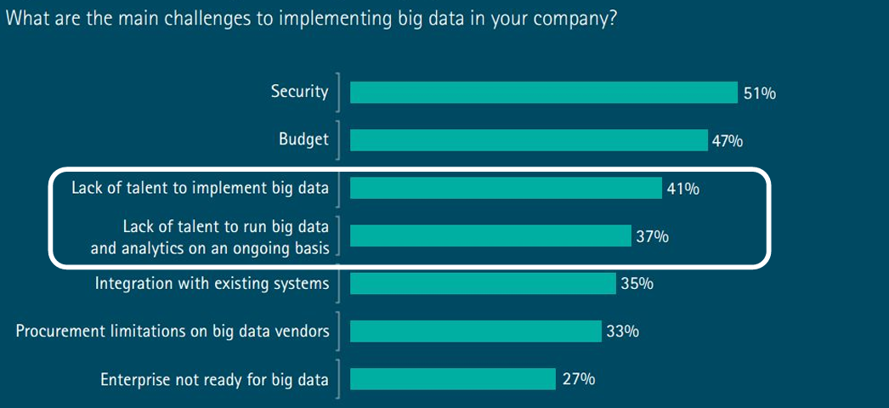
Big Data: Challenges and Opportunities
According to Accenture Big Success With Big Data Survey

Slide 34
Questions?

Slide 35
Acknowledgements
Some content in this presentation was inspired by and/or adapted from:
H. Andrew Schwartz’s lecture notes on “Big Data Analytics: What is Big Data?”
Minseok Seo’s lecture on “Introduction to Big Data”
Big Data Presentation Slides available at “https://www.slideteam.net/”

